Slide 1
Department of Applied Mathematics and Computational Sciences
II Sem M.Sc. Cyber Security
Discrete Structures
Dr. V. Suresh kumar

Slide 2
Graph Isomorphism

Slide 3
DEFINITION

Slide 4
EXAMPLE
Show that the graphs $G = (V ,E)$and $H = (W, F)$, displayed in the $Figure$ below, are isomorphic.

Slide 5
Necessary condition (Graph invariant)
Isomorphic simple graphs must have the same number of vertices
Isomorphic simple graphs also must have the same number of edges
In addition, the degrees of the vertices in isomorphic simple graphs must be the same
That is, a vertex $v$ of degree $d$ in $G$ must correspond to a vertex $f(v)$ of degree $d$ in $H$
because a vertex $w$ in $G$ is adjacent to $v$ if and only if $f(v)$ and $f(w)$ are adjacent in $H$.
The number of vertices, the number of edges, and the number of vertices of each degree are all invariants under isomorphism.
If any of these quantities differ in two simple graphs, these graphs cannot be isomorphic.
However, when these invariants are the same, it does not necessarily mean that the two graphs are isomorphic.
There are no useful sets of invariants currently known that can be used to determine whether simple graphs are isomorphic

Slide 6
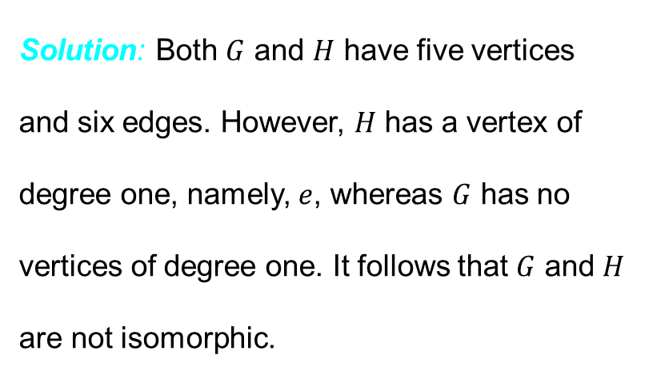
EXAMPLE
Determine whether the Graphs $G$ and $H$ shown below are Isomorphic.
Solution: Both $G$ and $H$ have five vertices and six edges. However, $H$ has a vertex of degree one, namely, $e$, whereas $G$ has no vertices of degree one. It follows that $G$ and $H$ are not isomorphic.

Slide 7
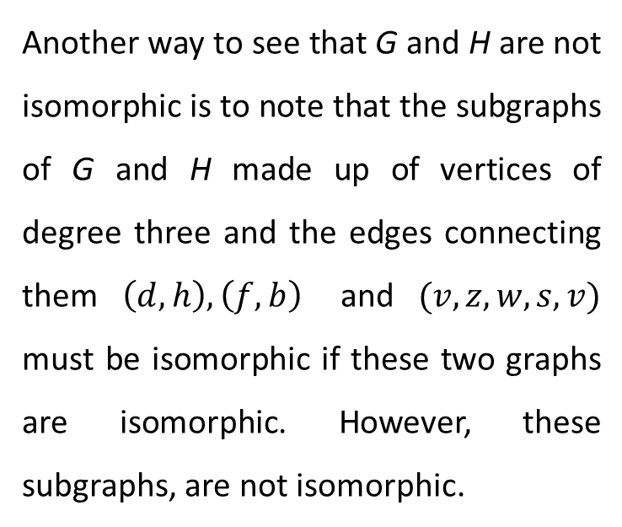
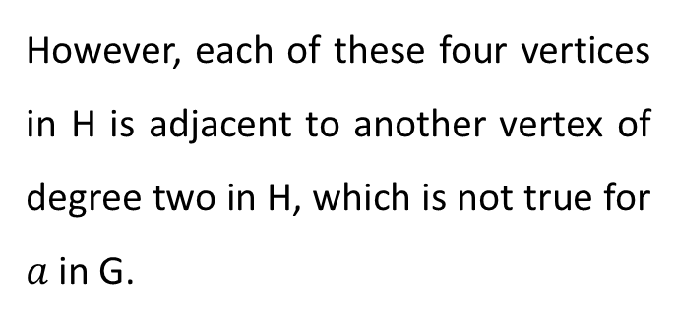
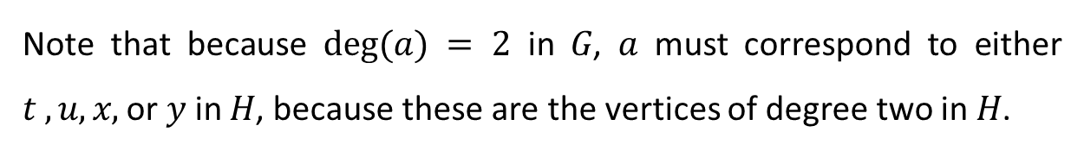
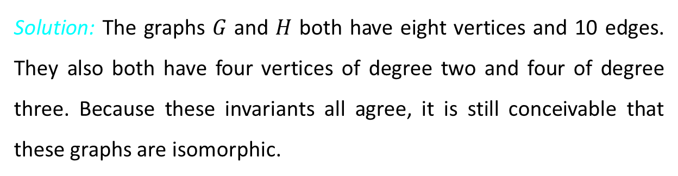
EXAMPLE
Determine whether the Graphs $G$ and $H$ shown below are Isomorphic.
However, each of these four vertices in H is adjacent to another vertex of degree two in H, which is not true for $a$ in G.
Therefor, G and H are not isomorphic.
Another way to see that G and H are not isomorphic is to note that the subgraphs of G and H made up of vertices of degree three and the edges connecting them $\left(d,h\right), \left(f,b\right)$ and $(v,z,w,s,v)$ must be isomorphic if these two graphs are isomorphic. However, these subgraphs, are not isomorphic.
Solution: The graphs $G$ and $H$ both have eight vertices and 10 edges. They also both have four vertices of degree two and four of degree three. Because these invariants all agree, it is still conceivable that these graphs are isomorphic.
Note that because $deg(a) = 2$ in $G$, $a$ must correspond to either $t , u, x,$ or $y$ in $H$, because these are the vertices of degree two in $H$.

Slide 8

EXAMPLE
Determine whether the Graphs $G$ and $H$ shown below are Isomorphic.
Solution: Both $G$ and $H$ have six vertices and seven edges.
Because $G$ and $H$ agree with respect to these invariants, it is reasonable to try to find an isomorphism $f$
Both have four vertices of degree two and two vertices of degree three.
It is also easy to see that the subgraphs of G and H consisting of all vertices of degree two and the edges connecting them are isomorphic

Slide 9
Example Contd…
We now will define a function $f$ and then determine whether it is an isomorphism.
Because $deg⁡(u_{1}) = 2$ and because $u_{1}$ is not adjacent to any other vertex of degree two,
The image of $u_{1}$ must be either $v_{4}$ or $v_{6}$, the only vertices of degree two in $H$ not adjacent to a vertex of degree two.
We arbitrarily set $f(u_{1}) = v_{6}$.
If we found that this choice did not lead to isomorphism, we would then try $f(u_{1}) = v_{4}$.
Because $u_{2}$ is adjacent to $u_{1}$, the possible images of $u_{2}$ are $v_{3}$ and $v_{5}$.
We arbitrarily set $f(u_{2}) = v_{3}$.
Continuing in this way, using adjacency of vertices and degrees as a guide, we set $f\left(u_{3}\right)=v_{4}$, $f(u_{4})=v_{5}$, $f(u_{5})=v_{1}$, and $f(u_{6}) = v_{2}$.
We now have a one-to-one correspondence between the vertex set of $G$ and the vertex set of $H$,
$f(u_{1}) = v_{6}, f(u_{2}) =v_{3}, f(u_{3}) = v_{4}, f(u_{4})=v_{5}, f(u_{5})= v_{1}, f(u_{6})=v_{2}$.
To see whether $f$ preserves edges, we examine the adjacency matrix of $G \& H$

Slide 10
Example Contd…
Therefor, the two graphs G and H are isomorphic.

Slide 11


